Slide 1
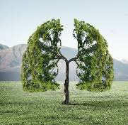
Lets Get Some Fresh Air:
The physiology of Oxygen Transport
Dr. Ketaki Kamble

Slide 2
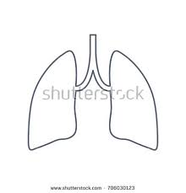
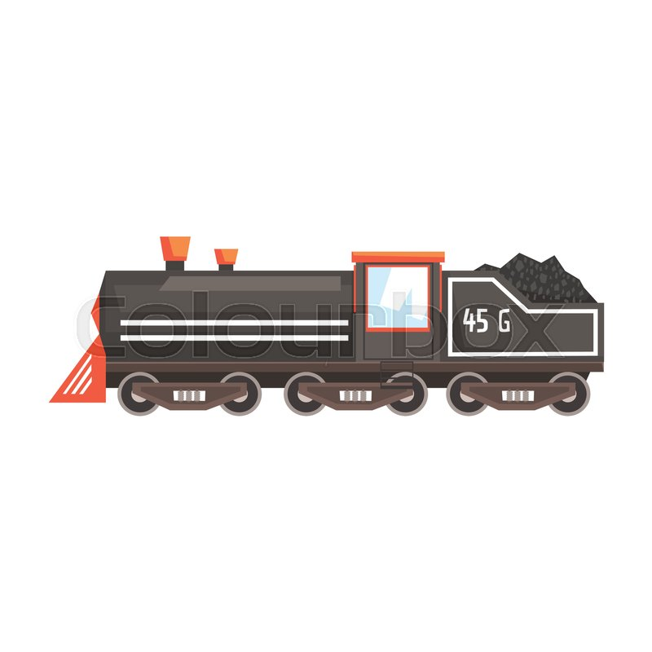
Energy dynamics within a cell
Carbohydrates, Fatty acids, Proteins
O₂
CO₂
H₂O
Energy
O₂
O₂
O₂
O₂
O₂
O₂
O₂
Cells
Lungs
CO₂
CO₂
CO₂
CO₂
CO₂

Slide 3
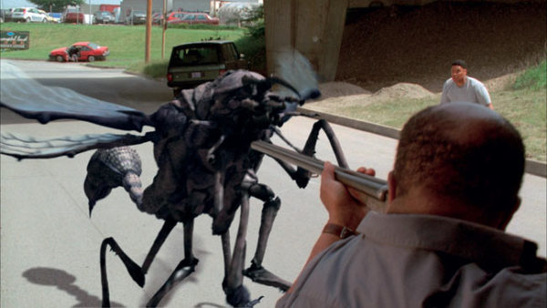
Still from movie- 8 legged creeps.
Do such large sized insects exist in nature?

Slide 4
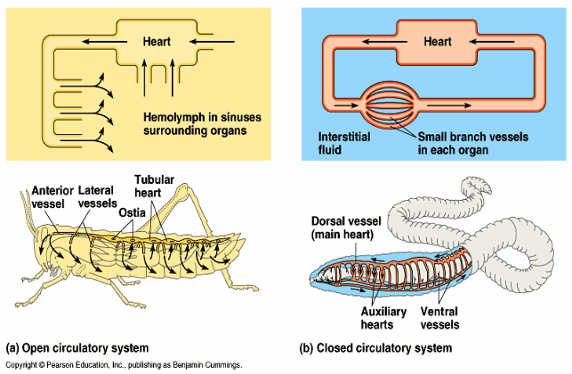
Types of Circulatory system
OPEN Circulatory system
CLOSED Circulatory system
O₂
Oxygen transport by Passive Diffusion.
Active pumping of Oxygen carrying blood.

Slide 5
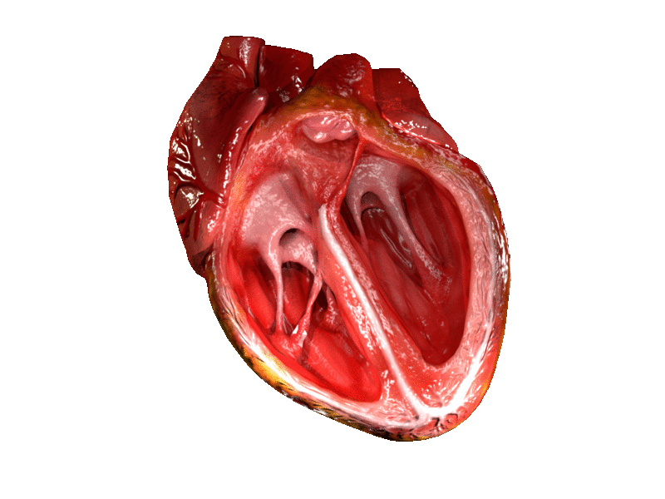
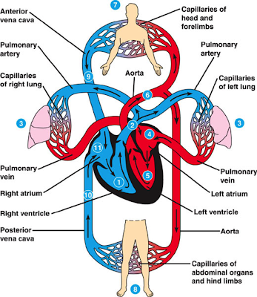
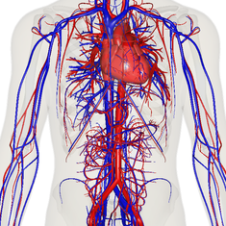
Human circulatory system

Slide 6
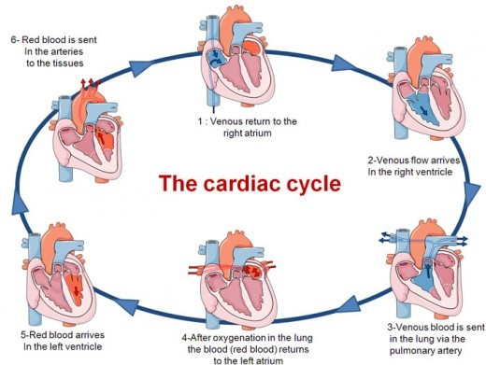

Slide 7
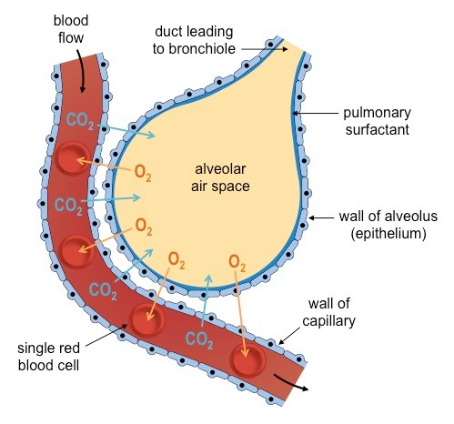
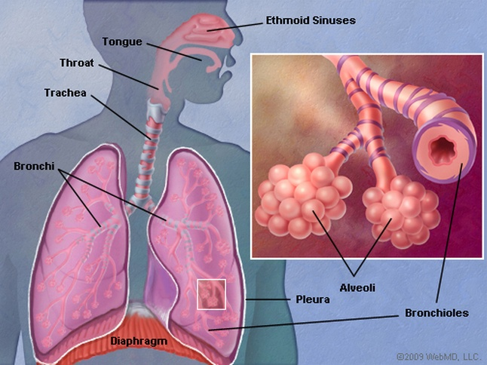
Transport of oxygen and Carbon dioxide in humans
Fick’s law of Diffusion: is the molar flux of diffusion is proportional to the concentration gradient.

Slide 8

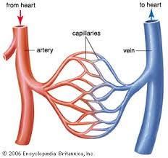
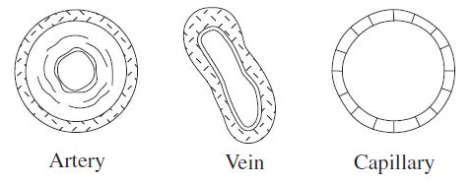
The Transport of essential gases
Veins | Number | Aggregate cross sectional area
Aorta | 1 | 4
Arteries | 8000 | 63
Arterioles | 2*10⁷ | 141
Capillaries | 1.4*10¹⁰ | 2827
As the total cross sectional area of the vessels increases, the velocity of the flow decreases. This facilitates the exchange of gases.

Slide 9
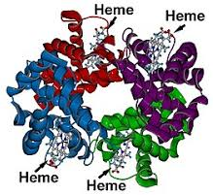
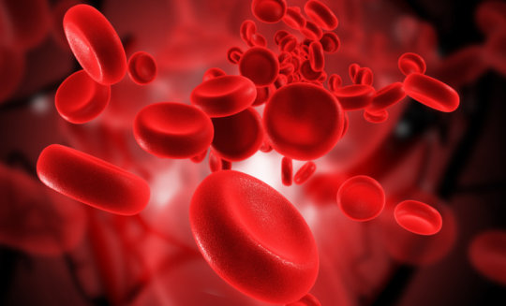
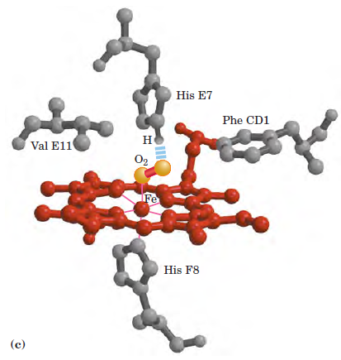
Hemoglobin: the carrier molecule
Shape of Red Blood Cells- their biconcave shape gives blood cell a larger surface area – which increases the ability to absorb oxygen.
O₂ + Hb → HbO₂
deoxy
oxy

Slide 10
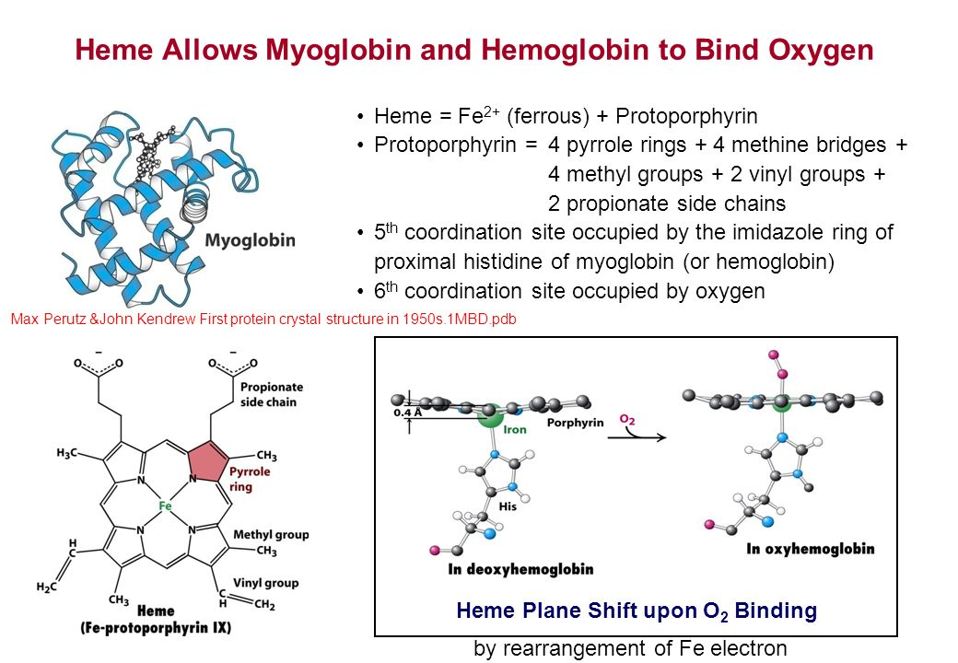

Slide 11
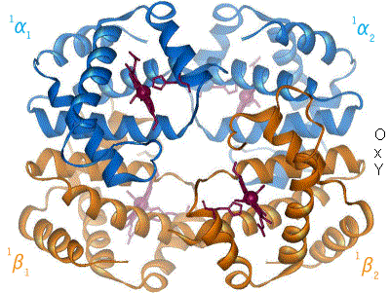
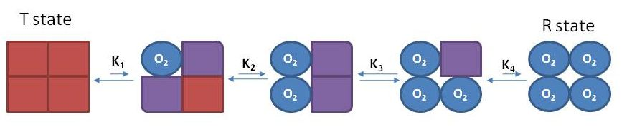
Hemoglobin: the carrier molecule
Deoxy Hb
Oxy Hb

Slide 12
Reversible Binding
Binding Affinity- The readiness at which the binding of oxygen to hemoglobin occurs .
Expressed in terms of fractional saturation of binding sites in hemoglobin, at given oxygen concentration.
Deoxy state has low affinity for Oxygen, while Oxy state has high affinity for oxygen to facilitate reversible binding. WHY?

Slide 13
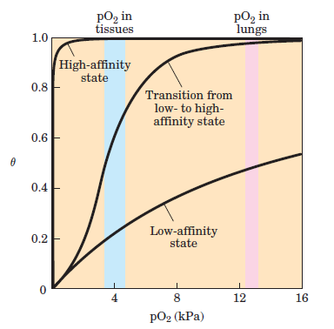
A protein that bound O2 with high affinity would bind it efficiently in the lungs but would not release much of it in the tissues. If the protein bound oxygen with a sufficiently low affinity to release it in the tissues, it would not pick up much oxygen in the lungs.
Hemoglobin solves the problem by undergoing a transition from a low-affinity state (the T state) to a high-affinity state (the R state) as more O2 molecules are bound. As a result, hemoglobin has a hybrid S-shaped, or sigmoid, binding curve for oxygen.

Slide 14
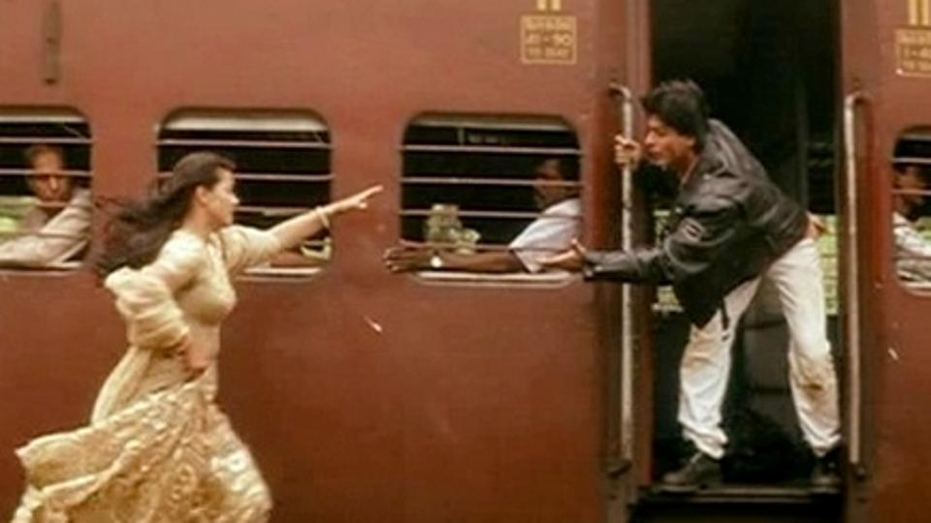
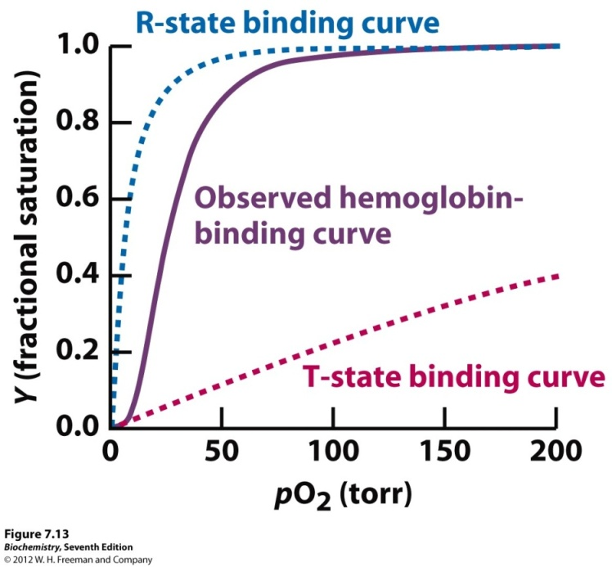
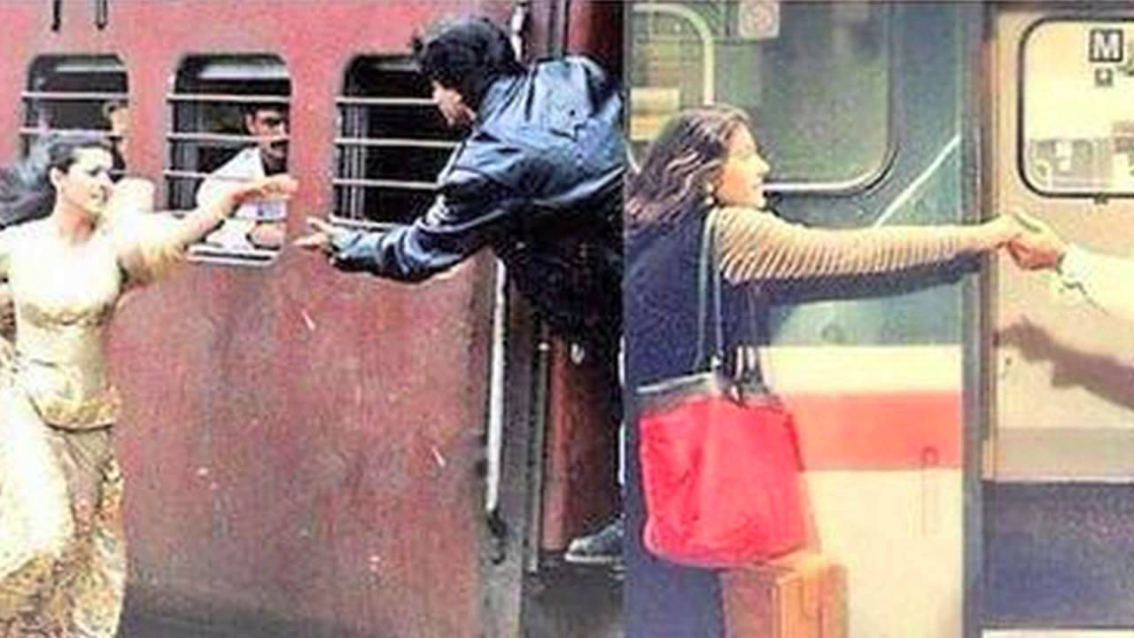
Hemoglobin: the carrier molecule
Oxygen
Hemoglobin subunit
Hemoglobin subunit
Oxygen

Slide 15
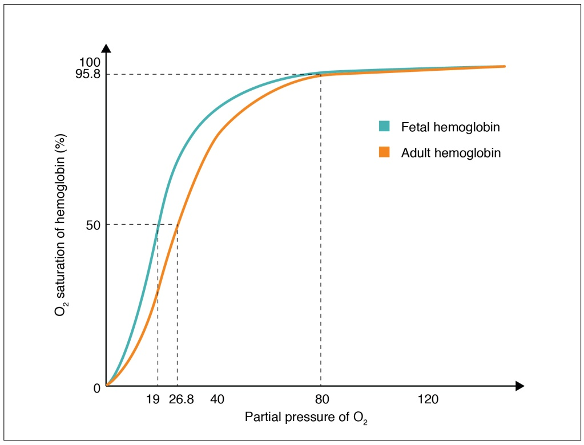
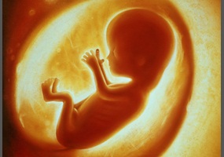
The Fetal Hemoglobin
Fetal hemoglobin has higher affinity to oxygen than adult hemoglobin.

Slide 16

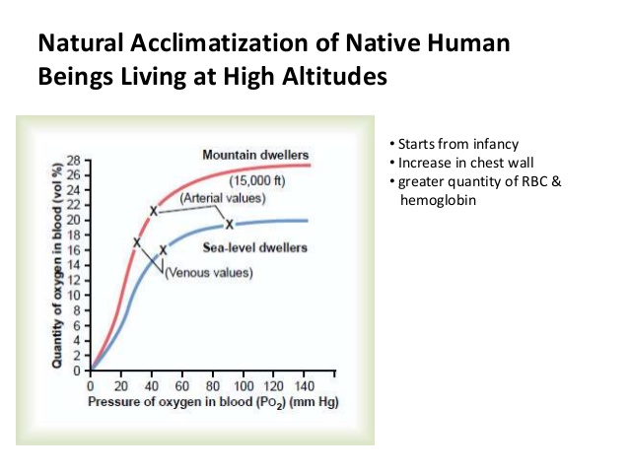

Slide 17
The overview of O₂ transport
Lungs
Blood
Cells
O₂
Lungs
Blood
Remote Cells
Diffusion
Reversible Binding with Hb
Diffusion
CO₂

Slide 18
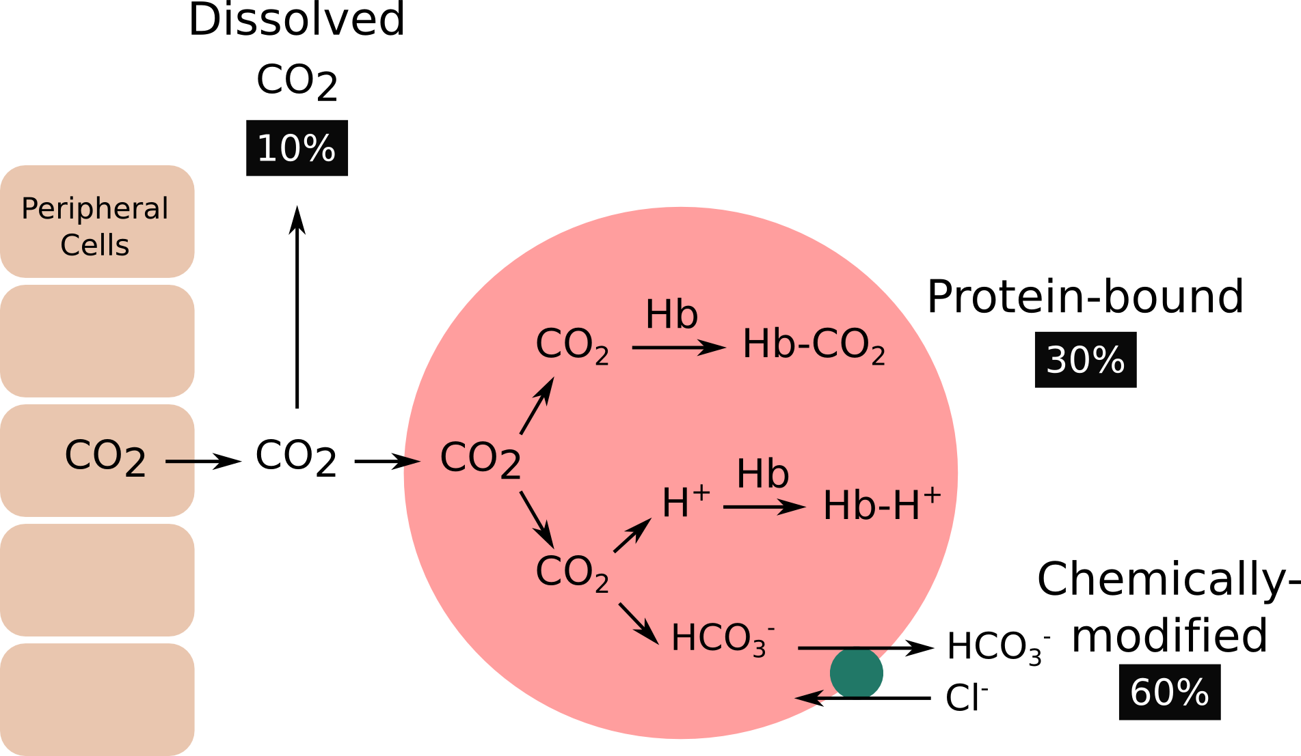
CO₂ transport
Hemoglobin carries two end products of cellular respiration—H and CO2— from the tissues to the lungs and the kidneys, where they are excreted. The CO2, produced by oxidation of organic fuels in mitochondria, is hydrated to form bicarbonate.
This reaction is catalyzed by carbonic anhydrase, an enzyme particularly abundant in erythrocytes. Carbon dioxide is not very soluble in aqueous solution, and bubbles of CO2 would form in the tissues and blood if it were not converted to bicarbonate.

Slide 19
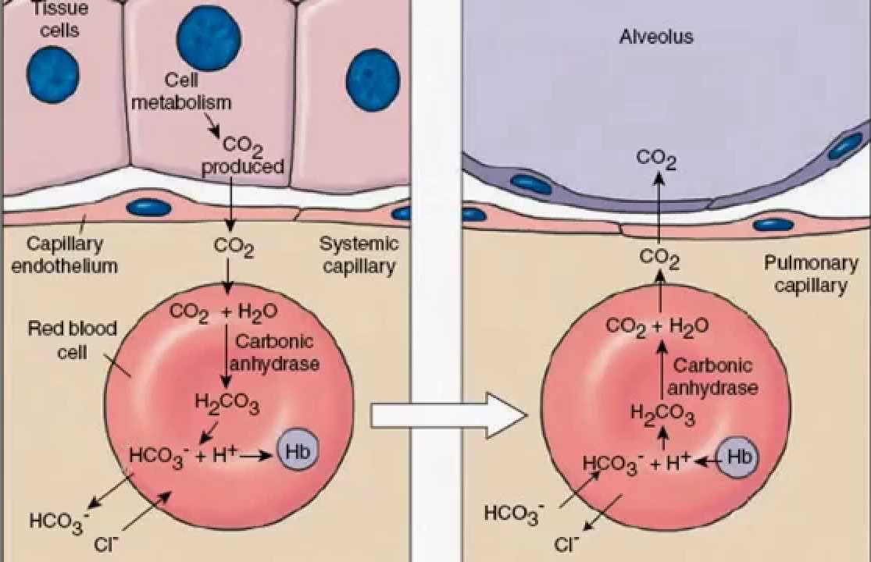
CO₂ transport

Slide 20
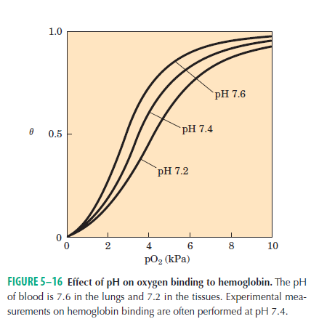
The Bohr Effect

Slide 21
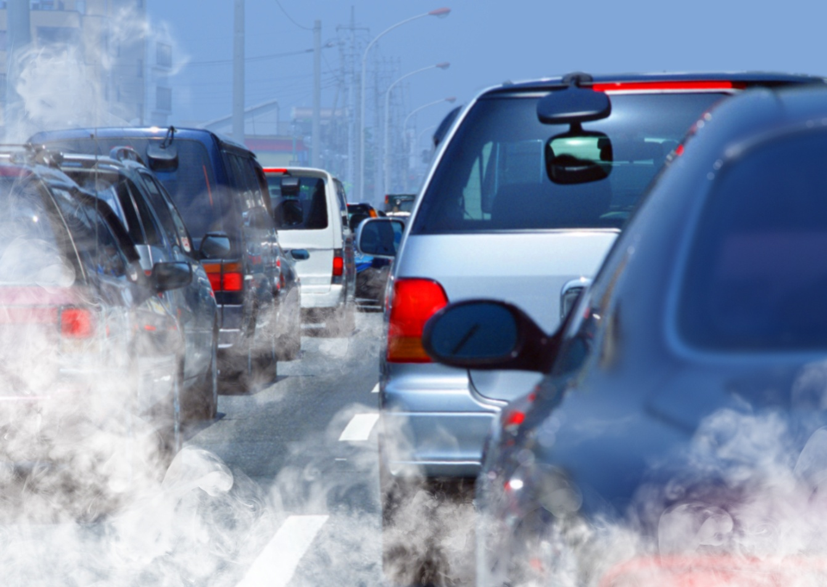
Carbon monoxide – the poison
Carbon monoxide has 100,000 times more affinity to heme than Oxygen.
But as it is strained in the binding pocket, its affinity is reduced 1000 times.
Still it is able to bind hemoglobin with 100 times more affinity.

Slide 22
Summary
Exchange of essential gases : lungs blood remote tissues
Physics of fluid flow
Chemistry of reversible binding of Hb
Evolution of:
1. Anatomical pump and pipelines (heart and blood vessels)
2. Carriers with reversible binding abilities (hemoglobin)
..makes large multi-cellular animals possible on earth.
Reference: Lehninger 6th edition Biochemsitry

Slide 23
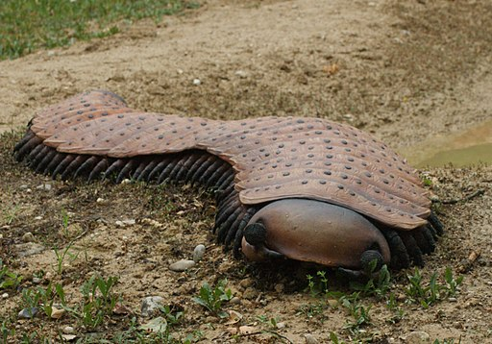
Arthropluera
9 ft
Thank you.

